Slide 1
Types of Fractures and Steps of Bone Repair
Human Anatomy and Physiology
Mrs. Krivicich
November 17, 2015

Slide 2
Classification of Fractures
Position of the bone ends after fracture.
Nondisplaced fractures: bone ends retain their normal position
Displaced Fractures- bone ends are out of normal position
2. Completeness of break:
Complete Fracture: If bone is broken through the fracture.
Incomplete Fracture: If bone is not broken through the fracture.

Slide 3
Classification of Fractures
3. Orientation of the break relative to the long axis of the bone.
Linear fracture: Break is parallel to the long axis.
Transverse- Break is perpendicular to the long axis of bone.
4. Whether bone ends penetrate the skin.
Compound Fracture: Bone penetrates through skin.
Closed (Simple) Fracture: Bone ends do not penetrate skin.

Slide 4
Common Types of Fractures
-Comminuted
-Spiral
-Depressed
-Compression
-Epiphyseal
-Greenstick

Slide 5
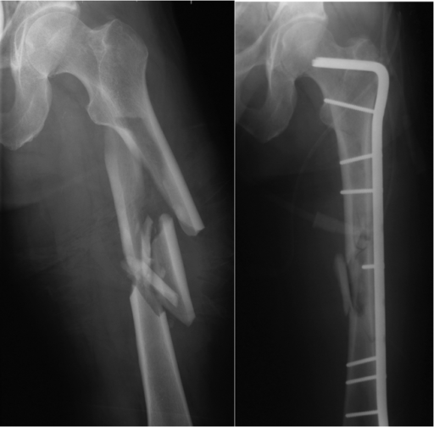
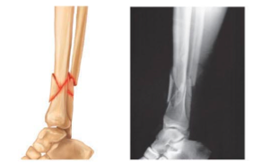
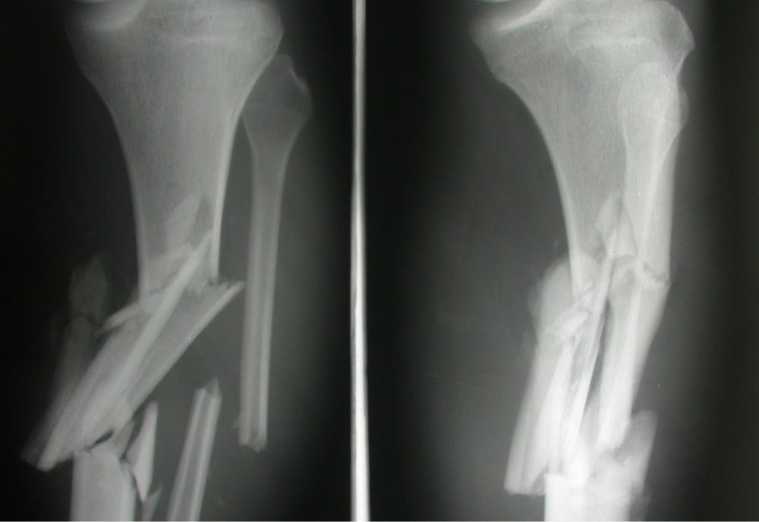
Comminuted Fractures
What is it? -when a bone fragments into three or more parts
Who is affected by it? particularly common in the aged, whose bones tend to be more brittle

Slide 6
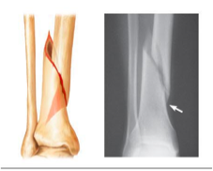
Spiral Fracture
What is it? a ragged break that occurs when excessive twisting forces are applied to a bone.
When does it happen? Common sports fracture
https://www.youtube.com/watch?v=lwVuW14_Fsc

Slide 7
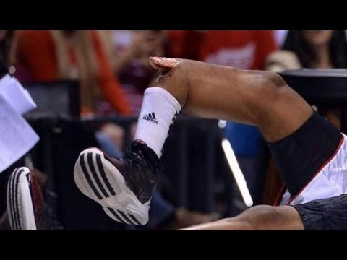
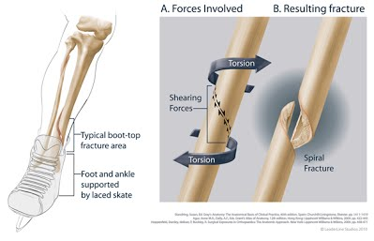
Spiral Fracture

Slide 8
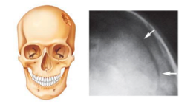
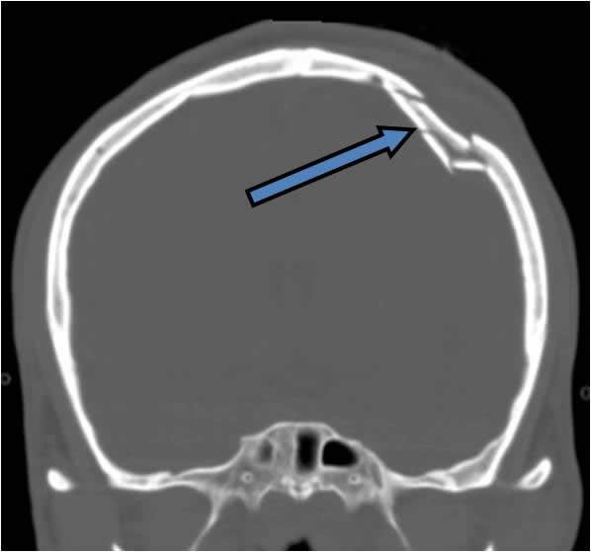
Depressed Fracture
What is it? -when broken bone portion is pressed inward
Where does this happen? typical of skull fracture
Cause? blunt force such as a fall or car accident or falling onto an object.

Slide 9
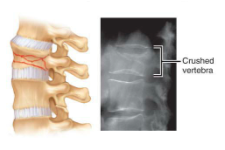
Compression Fractures
What is it? Bone is crushed.
Where does this happen? It happens in bones that are porous from osteoporosis.
Cause? Fall.

Slide 10
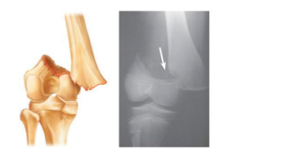
Epiphyseal Fracture
What is it? The epiphysis separates from the diaphysis along the epiphyseal plate.
Cause? The cartilage cells within the epiphyseal plate are dying and the calcification of the matrix is occurring.
Who does this happen for? children

Slide 11
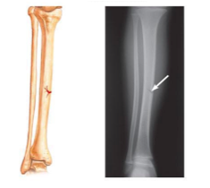
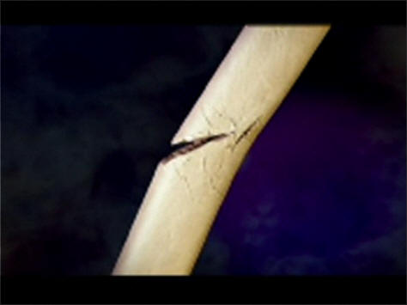
Greenstick Fractures
What is it? -when a bone is partially broken, the break does not make it all the way through the bone; like a green twig
Who does this affect? generally in children because their bones are more flexible and have more organic matrix
Cause? sadly, in child abuse cases

Slide 12
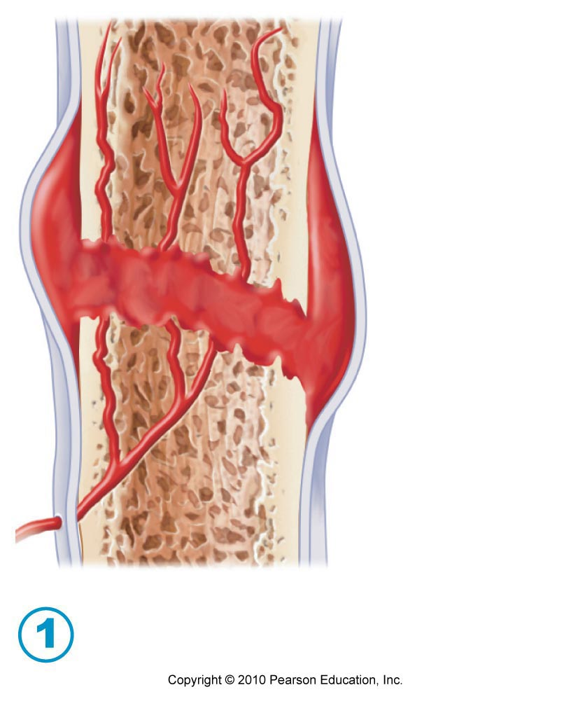
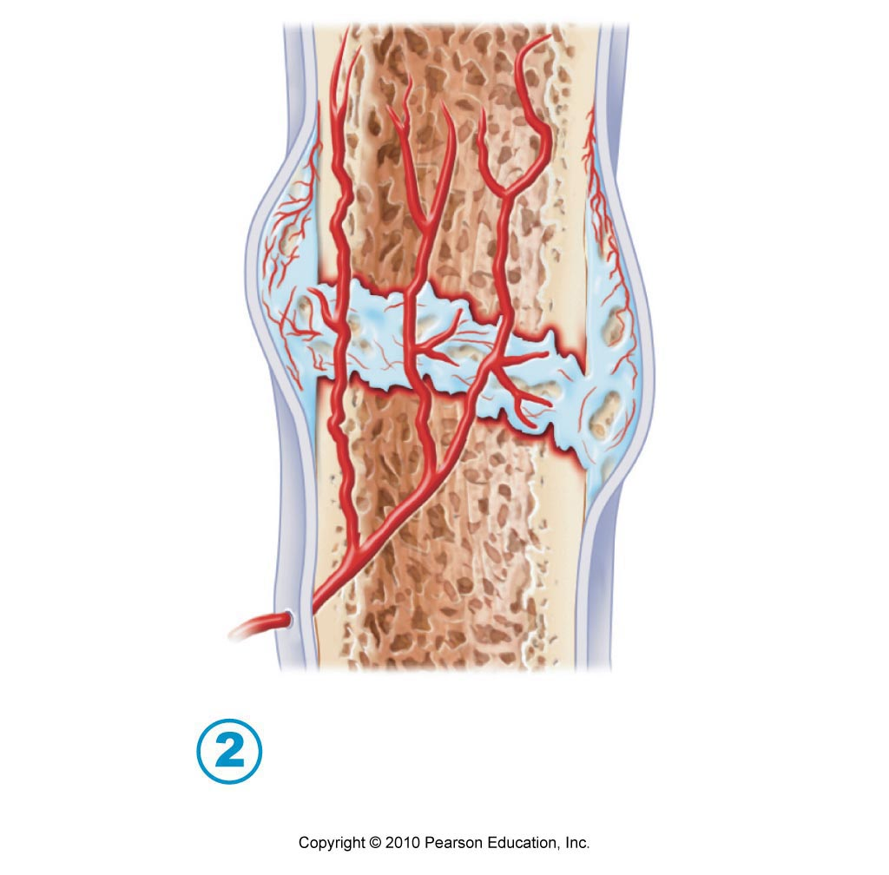
Bone Fracture Repair
Step 1 and Step 2
Hematoma: Massive Blood Clot, causes pain
Fibrocartilaginous callus forms
-Capillaries start to grow, phagocytic cells clean up debris, fibroblasts and osteoblasts invade

Slide 13
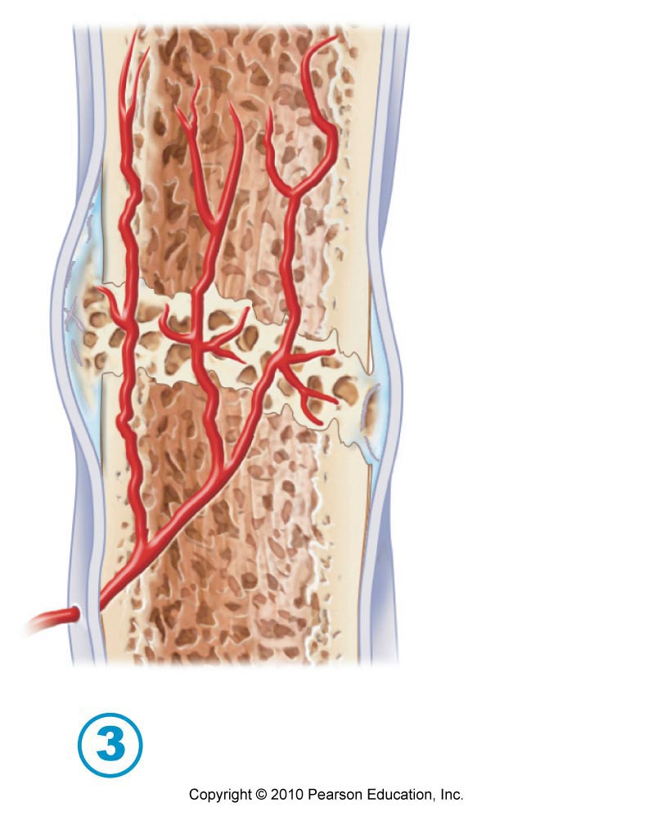
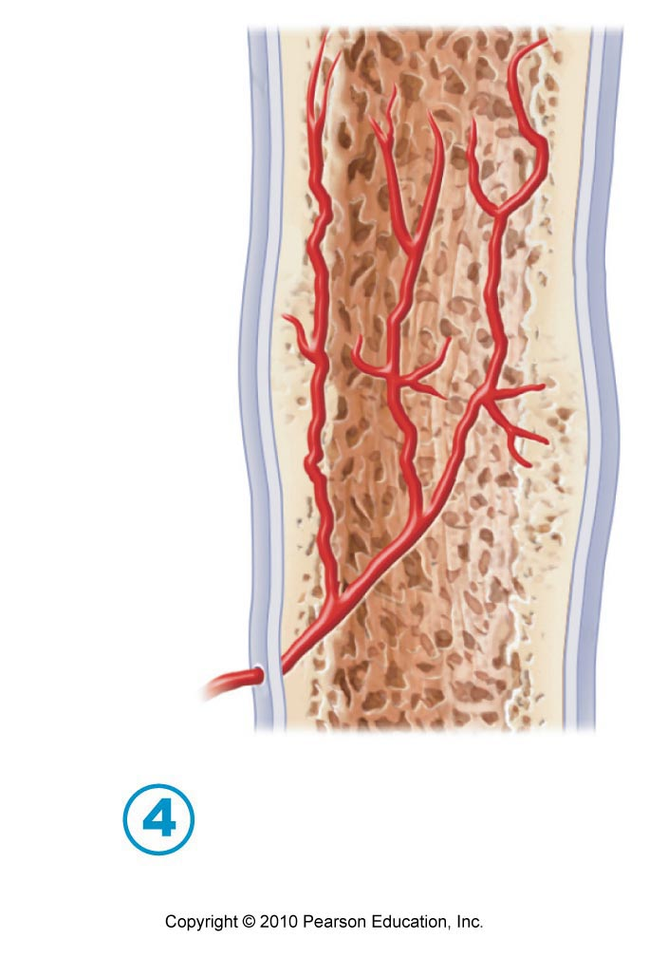
Bone Fracture Repair
Step 3 and 4
Bony callus forms. The new bone trabeculae gradually converts it to a callus of spongy bone.
Bone remodeling occurs. Continues for several months after the bony callus forms.

