Slide 1
BIOMES
7th Grade LS/ESS

Slide 2
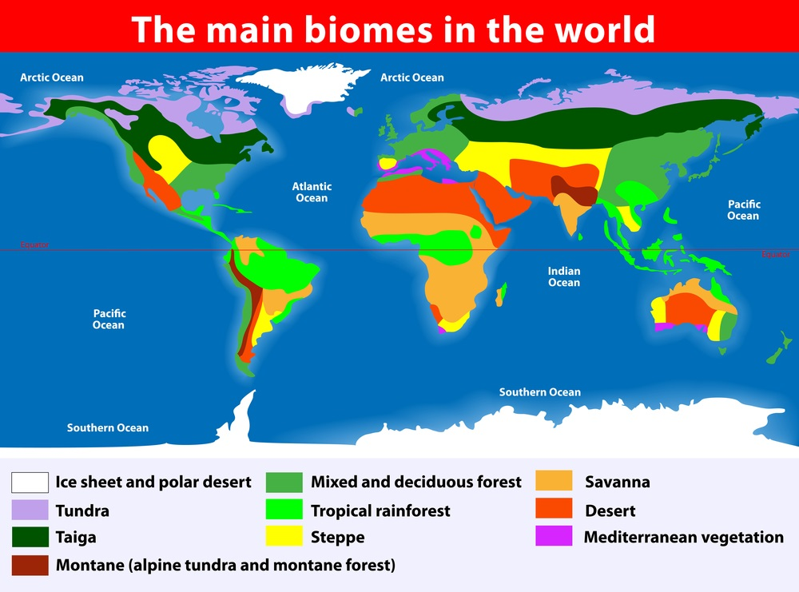
Biome
A BIOME is a formation of plants and animals that have common characteristics due to similar climates and can be found over a range of continents.

Slide 3
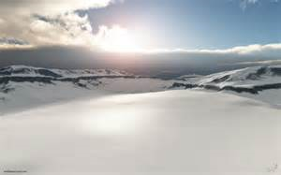
Tundra
The TUNDRA is a cold, dry treeless, region, sometimes called a cold desert.
Precipitation: Average less than 25 cm per year
Sun never appears above the horizon
Temperature: Average – 12 degrees C

Slide 4
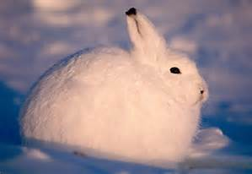
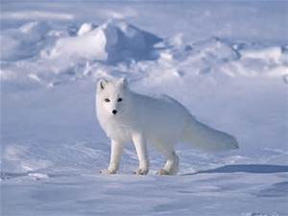
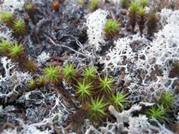
Tundra Organisms
Animals: Mice, voles, Lemmings, Artic Hares, Caribou
Plants: mosses, grasses, small shrubs

Slide 5
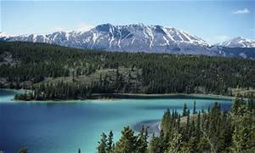
Taiga
Taiga is a Cold, forest region dominated by evergreen trees.
Precipitation: 35-100 cm per year
Warmer and wetter than a tundra

Slide 6
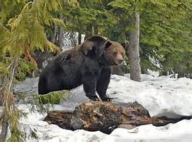
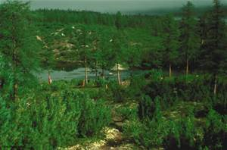
Taiga
Animals: Wolf, bear, squirrel, fish, birds
Plants, conifer trees, evergreen trees, small amounts of grasses and shrub species

Slide 7
Temperate/Deciduous Forest
Temperate Forests are made of trees that loses their leaves every autumn.
Precipitation: about 75-150cm per year
Temperature: -15 degrees C through 30 degrees C

Slide 8
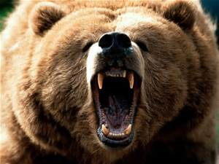
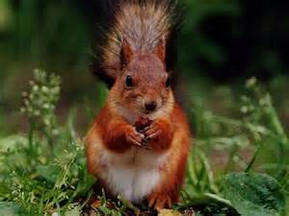
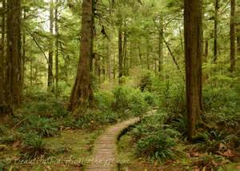
Temperate Forest Organisms
Animals: Deer, Rabbits, geese, bear, wolf
Plants: Deciduous trees, shrubs, mosses, grass

Slide 9
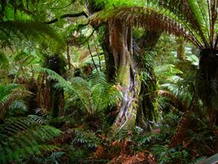
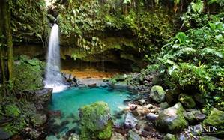
Tropical Rain Forest
Tropical Rainforests are regions with warm temperatures, wet weather, and lush plant growth.
Near the equator
Average temperature: 25 degrees C
Precipitation 200 cm-600 cm a year

Slide 10
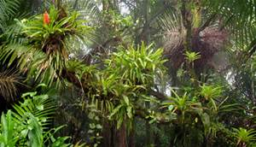
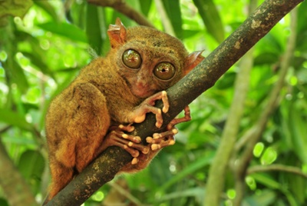
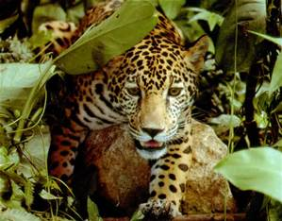
Rainforest Organisms
Rainforests carry that largest diversity of living things than all biomes!
Animals: Monkeys, 1000 of birds species and insect species, frogs, large cats
Plants, Canopy trees, vines, underbrush bushes and grasses, mosses

Slide 11
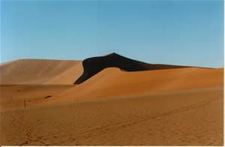
Desert
Deserts are the driest biomes.
Precipitation: less than 25 cm of rain a year
Little plant life
Windblown sand dunes
13-24 degrees C

Slide 12
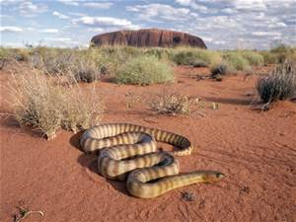
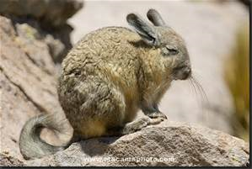
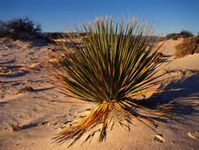
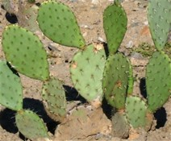
Desert Organisms
Animals: snakes, rodents, birds, lizards
Plants: Cacti, small bushes

Slide 13
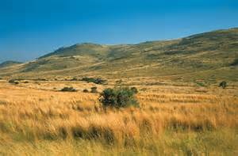
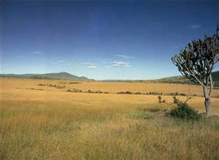
Grassland
GRASSLANDS are regions that have climax communities that are dominated by grasses.
Precipitation: between 25cm-75cm each year. Includes periods of wet and periods of dry spells to prevent forests.
Location: Prairies in North America, Savannas in Africa, Asia.
Temperature -40 degrees C (winter) – 38 degrees C (Summer)

Slide 14
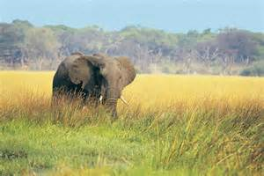
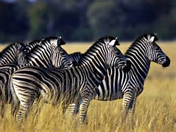
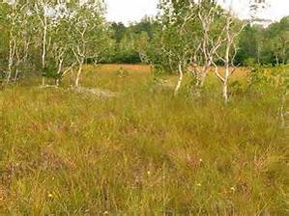
Grassland Organisms
Animals: wildebeests, impalas, zebras, kangaroos
Plants: wheat, barley, corn, rye, grasses

