Slide 1
Continental Drift
Our changing Earth

Slide 2
Continental Drift
Why does our Earth look the way it does?
How did this modern Earth come about?
Was it always the way it is today or was it once different?
If it was different, what caused it to change?
https://youtu.be/AFVwxZFx7ZY
Watch for misconceptions…

Slide 3
Continental Drift
Continental drift: a Hypothesis suggested by Alfred Wagner, a German meteorologist, that says our continents have moved slowly to their current positions.
https://youtu.be/ryrXAGY1dmE
Lets see this in motion:
https://youtu.be/cQVoSyVu9rk

Slide 4
Continental Drift
Pangaea: Meaning “All Land”, is the term used to describe our Earths continents as one large land mass.

Slide 5
Continental Drift
Do you think that Wagner’s ideas about continental drift was accepted. Why or why not?

Slide 6
Continental Drift
Lets look at some evidence that Wagner used to back up his hypothesis.
Fossils
Climate
Rocks

Slide 7
Continental Drift
Fossil Clues: Besides the Puzzle-Like fit we saw earlier, fossils provide support for continental Drift.
Identical plant and animal fossils have been found across oceans!

Slide 8
Continental Drift

Slide 9
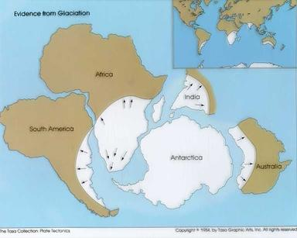
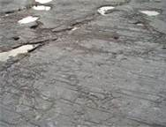
Continental Drift
Climate Clues: Wagner hypothesized that the ideas that some people could explain with climate changes he explained with drifting continents.
Examples: Glacial deposits, and fossil records

Slide 10
Continental Drift: A closer look!!

Slide 11
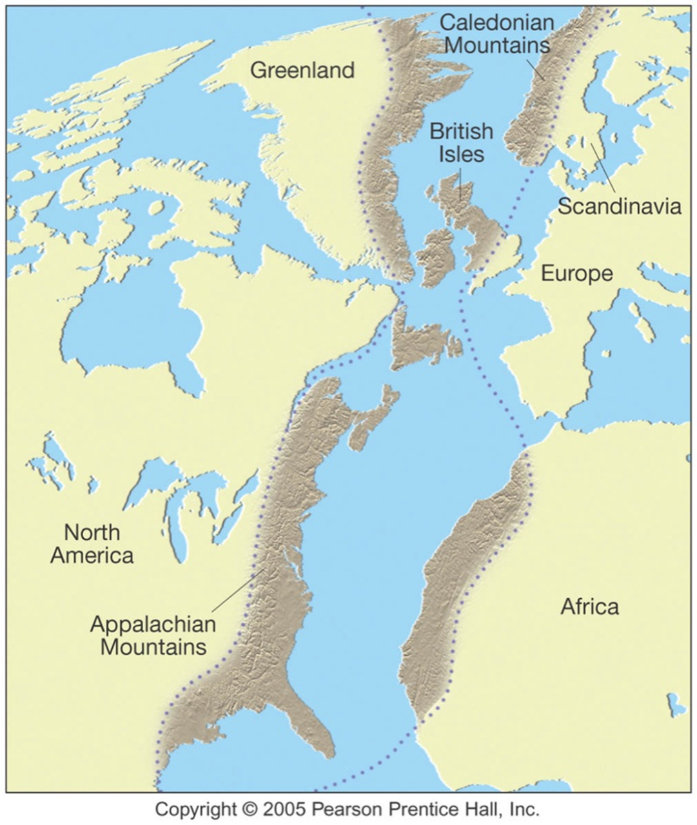
Continental Drift
Rock Clues: Similar rock structures are found on different continents.
Examples: Mountain ranges

Slide 12
Continental Drift
Over view interactive info and animation. http://wosu.pbslearningmedia.org/asset/lsps07_int_biogeography/

Slide 13
As you come in…
Lets review some ideas…
What is the term we use to describe our continents connected into one big land mass?
What are the three pieces of evidence supporting ALFRED Wagner’s theory!

Slide 14
Theory of Plate Tectonics
This theory that combines seafloor spreading and continental drift is called Plate tectonics

Slide 15
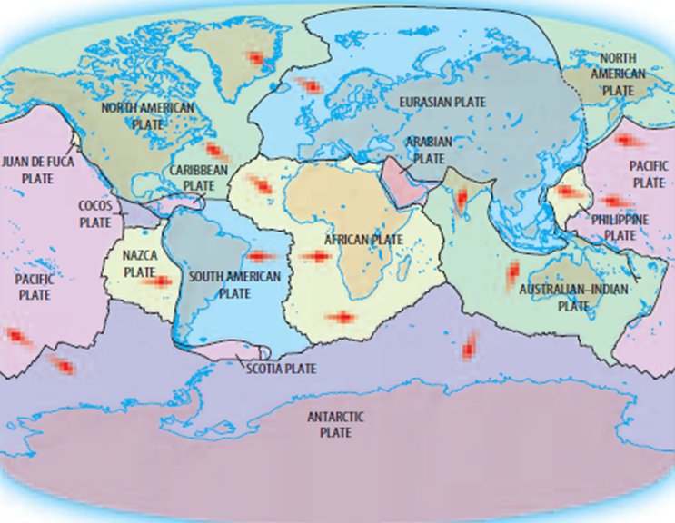
Theory of plate tectonics

Slide 16
Theory of plate tectonics
So what causes all of these plates to move to begin with??!!
Convection Currents: Process of heating, rising, cooling, and sinking within our earths mantle!

Slide 17
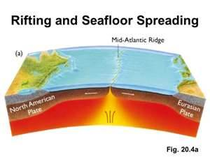
Seafloor spreading
Seafloor spreading: Harry Hess stated that hot, less dense material below Earths crust rises toward the surface at the mid-ocean ridges. Then, it flows sideways, carrying the seafloor away from the ridge in both directions.
Lets take a closer look: http://youtu.be/6CsTTmvX6mc
Only until 3:55!!! The rest will be watched during plate tectonics lesson

Slide 18
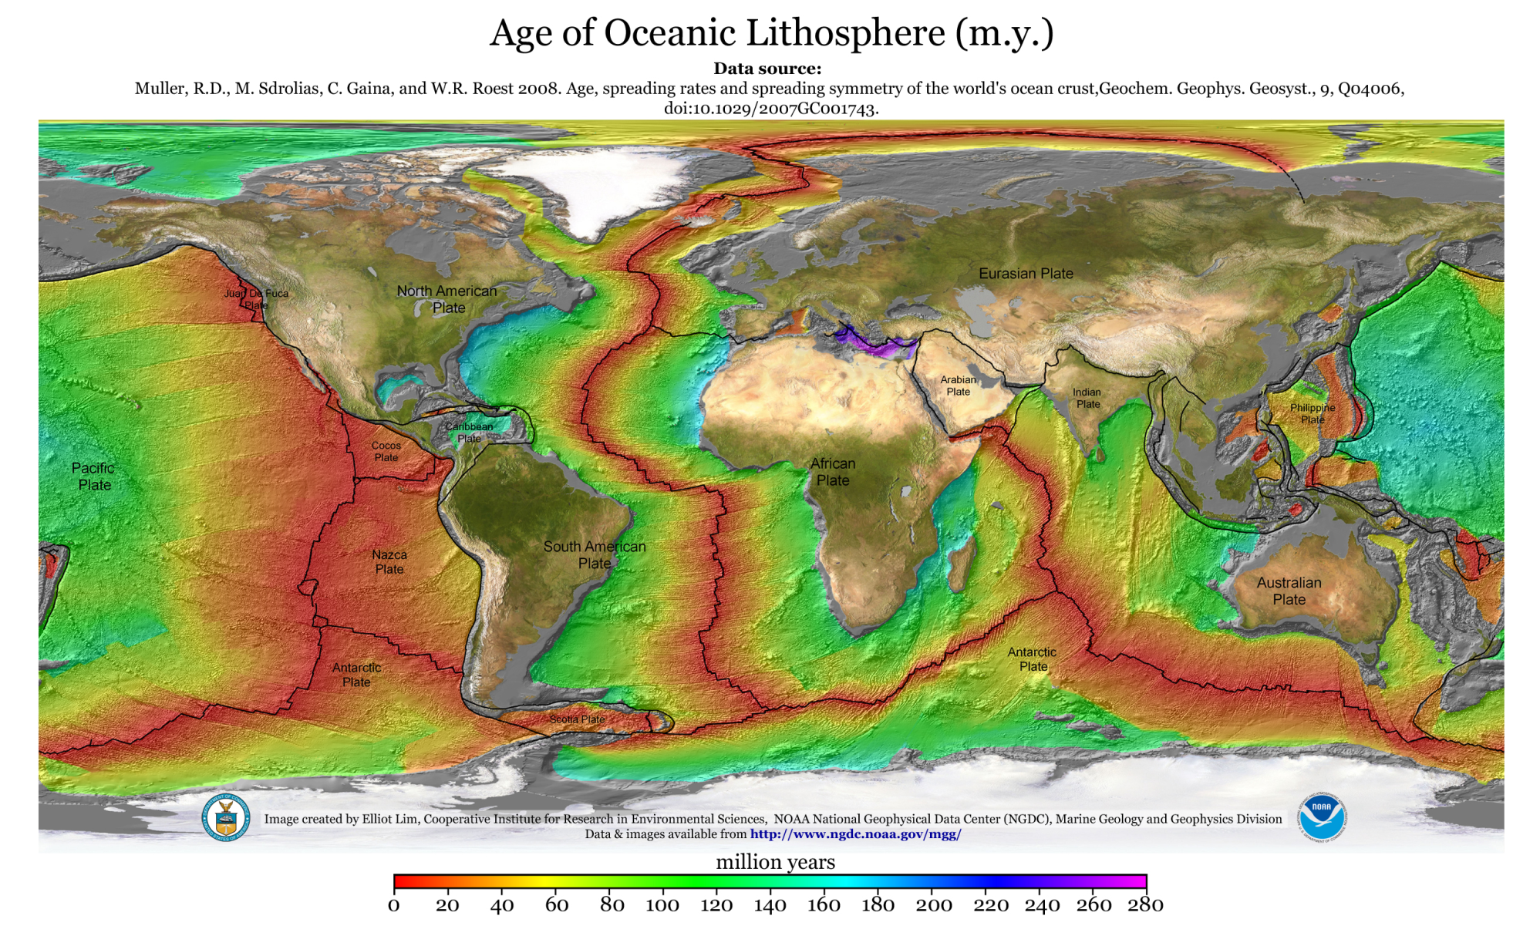
Seafloor spreading

Slide 19
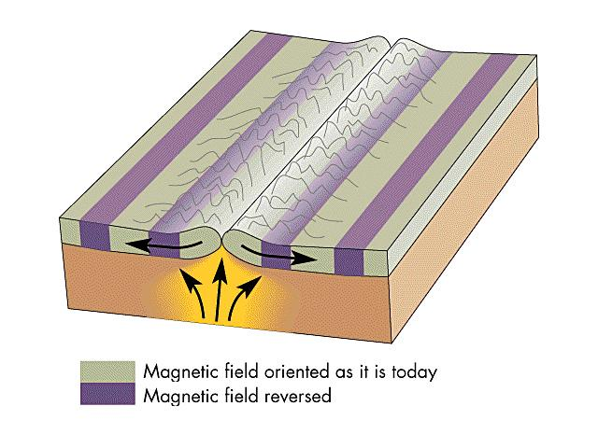
Seafloor Spreading
Magnetic clues supporting seafloor spreading
The magnetic poles currently have magnetic force leaving the south and entering near the north pole.
This direction switches every thousand-million years!
The proof is in the rock!!
http://youtu.be/YIAXiE8RedA

Slide 21
Seafloor Spreading
Overview
https://youtu.be/GyMLlLxbfa4?list=PLdAgn2D7dQ8W-OcnGzo8vAW-lnohyCc7r Bill Nye
https://youtu.be/oXYAdzmwQsc scary educational

Slide 22
Theory of plate tectonics
Plate tectonics ideas
Earths crust and part of the upper mantle(the lithosphere) are broken up into sections called plates.
These plates move above the other part of the upper mantle (the asthenosphere) like a raft on water.
Diagram * You're welcome Emerson ☺

Slide 23
Theory of plate tectonics

Slide 24
Theory of plate tectonics
There are about 12 main plate boundaries of the lithosphere.
When each plate interacts with the plates that surround it, the result of their movements is seen at the plate boundaries.

Slide 25
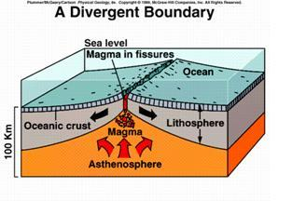
Theory of plate tectonics
Divergent Boundary: Plates that are moving apart!
Caused the
Mid-Atlantic ridge
and faults/valleys

Slide 26
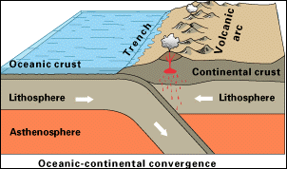
Theory of plate tectonics
There are two kinds of plate boundaries that move together
Convergent Boundary: Plates that move together and collide or submerge.
Causes Mountains
Volcanoes and
Trenches

Slide 27
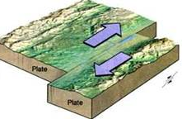
Theory Of plate tectonics
Transform Boundary: When plates slide side by side past one another.
Causes Earthquakes

Slide 28
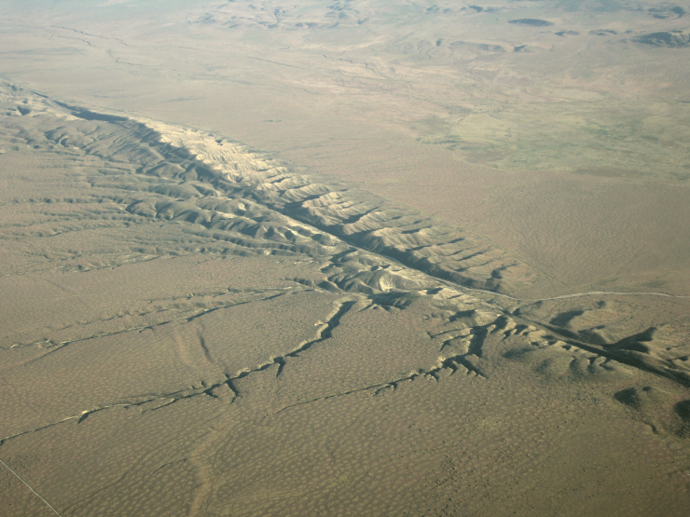
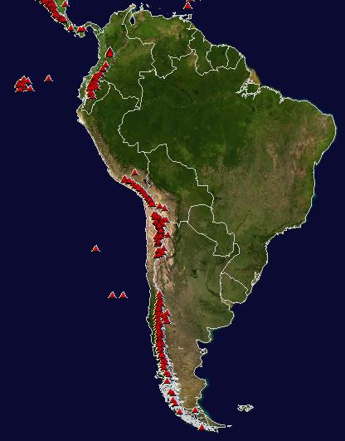
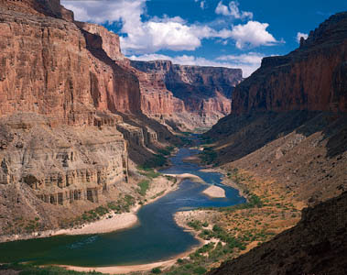
Theory of plate tectonics
Famous examples.
San Andrea Fault in California
South America Volcanoes
Great Rift Valley

Slide 29
Lets overview these boundaries!!
http://wosu.pbslearningmedia.org/asset/ess05_int_shake/
Crash Course: 3:00-4:00
https://youtu.be/w-9gDALvMF4?list=PLdAgn2D7dQ8W-OcnGzo8vAW-lnohyCc7r

