Slide 1
Heredity
Chapter 11
Green Book

Slide 2
Big Ideas of this Chapter!!
Inherited genes determine an organism’s traits.
Using scientific methods, Gregor Mendel discovered the basic principles of genetics.
It is now known that interactions among alleles, genes, and the enviornment determine an organism’s traits.
Through genetic engineering, scientists can change the DNA of organisms to improve them, increase resistance to insects and diseases, or produce medicines.

Slide 3
Genetics
Heredity: is the passing of traits from parent to offspring.
Alleles: the different forms of a trait that make up a gene pair
For example, one allele may carry the trait for dimples while another may carry a trait for no dimples
The study of how traits are inherited through the interactions of alleles is the science of Genetics!

Slide 4
Genetics
Gregor Mendel was known as the father of genetics
He studied plant traits over several generations
He found that when crossing two plants with different traits, the offspring traits would come out looking like one of the two parents. The offspring that received alleles from both parents he called Hybrids.
Dominate traits/factors dominate, or cover up, the other allele or trait.
Recessive traits are the traits that get covered up or dominated over.

Slide 5
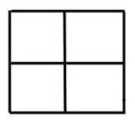
Genetics
Punnett Squares are one way that Mendel used to study these traits and the probability of them coming up in the offspring.
Uppercase letters stand for dominate traits/alleles
Lower case letters stand for recessive traits/alleles
These letters form a genetic code called a genotype.
Two of the same alleles as a genotype are considered to be homozygous(AA or aa), while two different alleles as a genotype are called heterozygous(Aa).

Slide 6
Mendelian Genetics video questions
http://www.bozemanscience.com/029-mendelian-genetics

Slide 7
Genetics Review
Which of these genotypes is Heterozygous? Which is Homozygous?
Aa, aa
Complete a Punnett square using the above genotypes and answer the following questions:
What is the probability of the offspring having a dominant genotype?
What is the probability of the offspring having a Homozygous genotype?

Slide 8
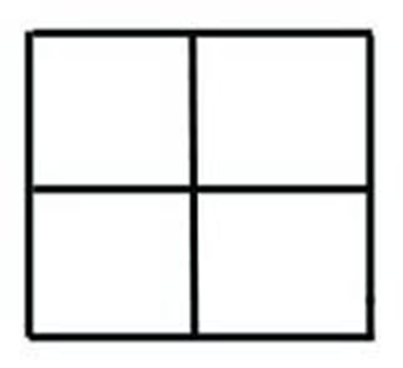
Genetics
Lets try applying this information:
Need more practice??

Slide 9
Genetics
Review
Sum up of Mendel's ideas:
Traits are controlled by alleles on chromosomes
An allele’s effect s dominant or recessive
When a pair of chromosomes separates during meiosis, the different alleles for a trait move into separate sex cells.
Questions!!!????

Slide 10
Genetics since Mendel
Incomplete dominance: two homozygous parents show an intermediate phenotype.
A A
a
a
Aa
Aa
Aa
Aa

Slide 11
Genetics since Mendel
Impact of the environment: Your environment plays a role in how some of your genes are expressed or whether they are expressed at all (Can be internal or external).
Cancer/Sunlight
Mutations- causes and effects: Changes in your body’s DNA. This can be caused by internal or external influences. Mutations can be positive or negative.
Webbed husband ☺ , x-rays ☹
Recessive Genetic Disorders: mutation from one or more parents, passed down to the child as a recessive disorder.
Cystic Fibrosis

Slide 12
Genetics since Mendel
Determining gender of a baby!!!
Females carry the XX allele and Males carry the XY allele.
What are the odds of me having a girl vs. having a boy??

Slide 13
Genetics since Mendel
Pedigree: a tool used to help follow a trait through generations of a family.
Colored=Have trait
Empty=Don’t have trait
Half-Colored= Carrier

Slide 14
Genetics since Mendel
Using Pedigrees
A pedigree is useful tool for geneticists.
When a geneticist studies past patterns in a pedigree, they can predict the outcome of the baby being born with a specific trait.
Breeders of animal and plants use this tool to make the “best” babies to sell.

Slide 15
Pedigree practice

