Slide 1
Speciation
Chapter 17.3 (p.414-416)

Slide 2
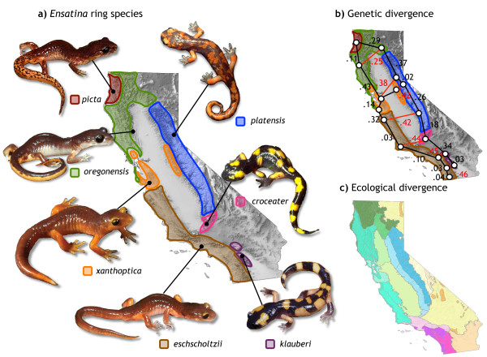

Slide 3
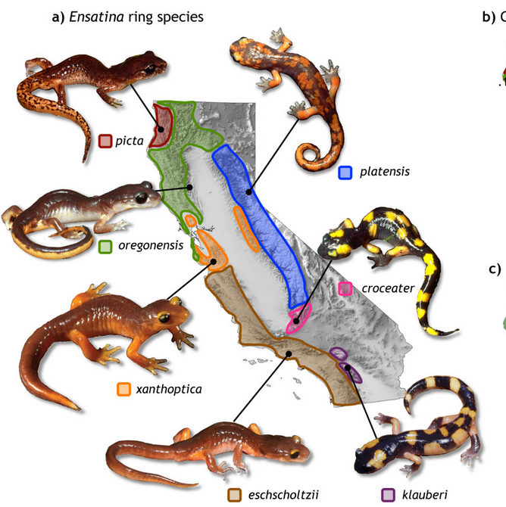
Species
A group of organisms that:
Breed with one another
Produce fertile offspring

Slide 4
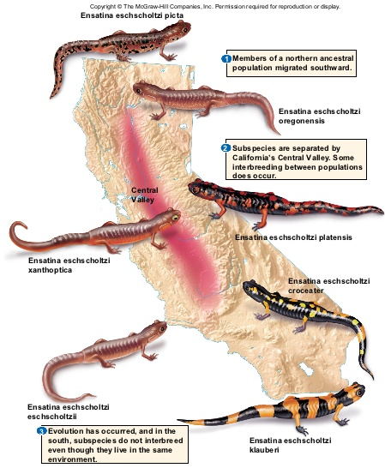
Speciation Begins When…
Reproductive isolation occurs.
Gene flow between populations stops.
Different environmental pressures exist.

Slide 5
Genetic Variation
Confers reproductive success in different environments.
Each environment selects for different variations.

Slide 6
Barriers to Reproduction
Geographic
Behavioral
Reduced hybrid viability

Slide 7
Additional Barriers
The longer populations remain reproductively isolated from one another the more genetic differences will accumulate, leading to additional reproductive barriers.
Temporal
Mechanical
Offspring sterility
Gametic

