Slide 1

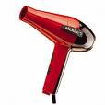
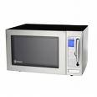
Warm-up
What happens to the potential energy of a snowboarder once he starts to snowboard down the side of a mountain?
As a tennis ball bounces up, back into your hand, what happens to its gravitational energy?
A blow dryer. A desk lamp. A microwave. An Xbox 360. What do all of these have in common?

Slide 2


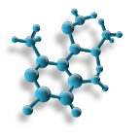

Slide 3
Energy
Is the ability to make change in matter and do work.
Example:
  The tennis player does work on her racket by exerting force on it.
  The racket does work on the ball.
  The ball does work on the net

Slide 4
Kinetic Energy
Is the energy of motion.
Kinetic energy depends on mass and speed.
The faster something is moving, the more kinetic energy it has.
Also, the more mass a moving object has, the greater its kinetic energy.
WHAT IS MASS?

Slide 5
Potential Energy
Is the stored energy an object has because of its position.
Example:
  The bow has potential energy because work has been done to change its shape.
  The man has potential energy because he is on the edge of the cliff.

Slide 6
Gravitational Potential Energy
Energy stored in an object’s height.
Books on a shelf have gravitational potential energy.
The higher the elevation, the more gravitational potential energy the object has.

Slide 7
Elastic Potential Energy
Energy stored in an object’s tension.
You change the shape of these objects by stretching them.
Examples: bowstrings, springs, rubber bands, the elastic in your socks, etc.

Slide 8
Chemical Energy
Energy stored in bonds of atoms and molcecules.
Before you eat that sugary drink or food, it has the potential to give you energy.
Food and drinks have chemical potential energy due to their chemical composition.
Other examples: batteries, gasoline, coal

Slide 9
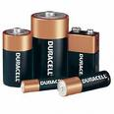
Example of Chemical Energy
Inside of batteries are chemicals that help provide the energy that powers things like calculators, toys, handheld games, and more!

Slide 10
Potential or Kinetic?
An apple on a tree.

Slide 11
Potential or Kinetic?
A rolling ball.

Slide 12
Potential or Kinetic?
A stretched rubber band.

Slide 13
Gravitational, Elastic, or Chemical?
Our food and drink.

Slide 14
Gravitational, Elastic, or Chemical?
A book on a shelf.

Slide 15
Gravitational, Elastic, or Chemical?
A stretched rubber band.

Slide 16
Nuclear Energy
Energy that comes from changes in the nucleus of an atom.
Large amounts of energy can be released when nuclei are split (fission) or combined (fusion).

Slide 17
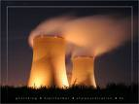
Example of Nuclear Energy
Humans have figured out a way to produce electricity using nuclear energy.

Slide 18
Which one has more Kinetic energy?
If Mrs. Snider rolled a bowling ball and a soccer ball down the aisle at the same speed, which one would have more kinetic energy?

Slide 19
Which one has more Kinetic Energy?
A tennis ball rolling slow or a tennis ball rolling fast?

Slide 20
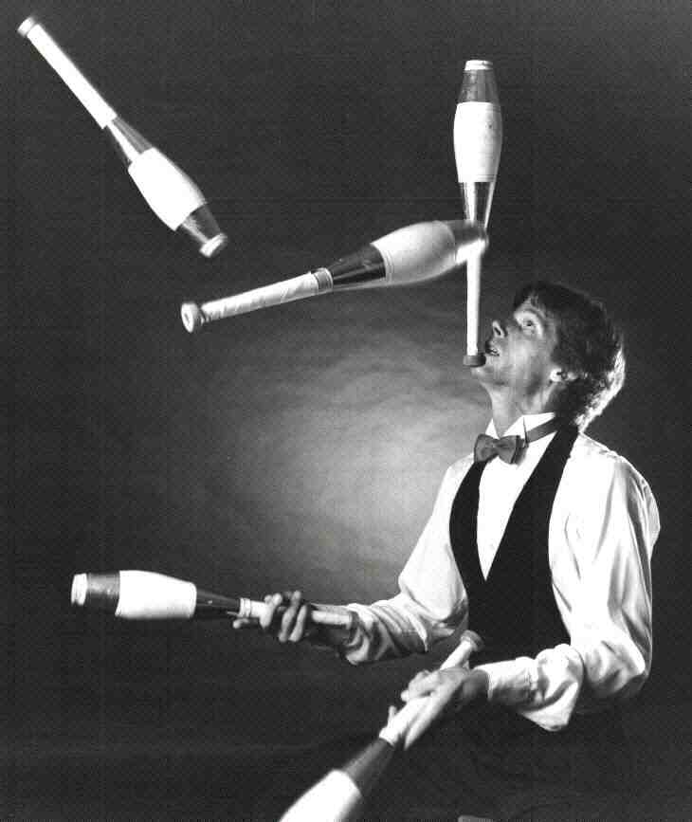
Mechanical Energy
The energy associated with the motion and position of an object

Slide 21
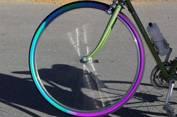
Example of Mechanical Energy
Anything that can be put into motion
A spinning wheel has mechanical energy that is kinetic .
When the wheel is still is has mechanical energy that is potential.

Slide 22
Thermal Energy
The vibration and movement of the atoms and molecules within substances.
The hotter something is, the more kinetic energy its particles have.
If something is cold, like ice, its particles are moving very slow, or have little kinetic energy.

Slide 23
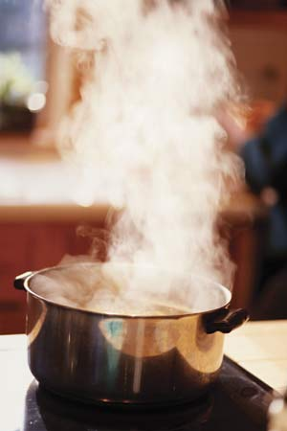
Example of Thermal Energy
Anything that has a temperature.
Water has thermal energy.

Slide 24
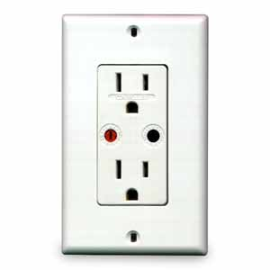
Electrical Energy
The energy of moving electrons (generally through a wire).
A.k.a. electricity!

Slide 25
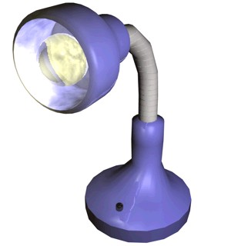
Example of Electrical Energy
Anything that is powered by electricity requires electrical energy!
Everyday appliances, like lamps, need electrical energy!

Slide 26
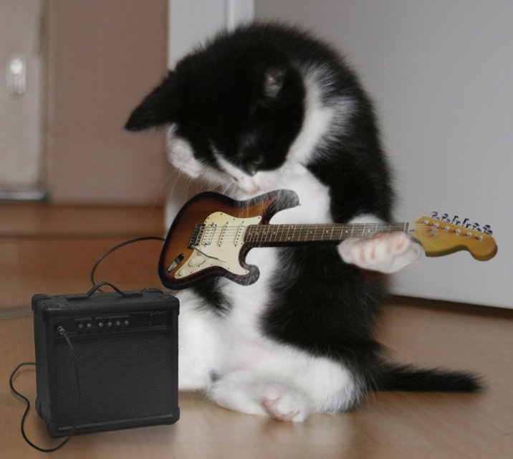
Sound Energy
An object’s vibrations transmit sound energy through the air.

Slide 27
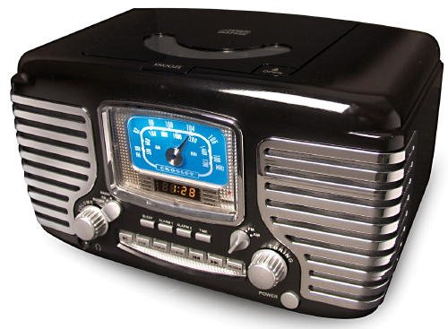
Example of Sound Energy
Anything that produces sound is giving off sound energy!
A radio playing music gives off sound energy!

Slide 28
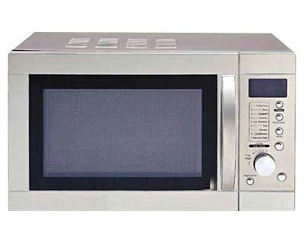
Radiant Energy
Produced by vibrations of electrically charged particles.
Includes visible light, x-rays, gamma rays, and radio waves.

Slide 29
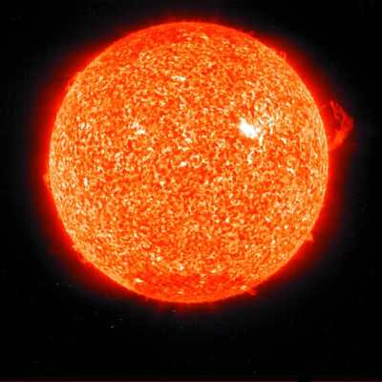
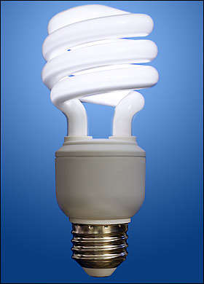
Example of Radiant Energy
Anything that produces a form of light!
Light bulbs and the sun give off radiant energy.

Slide 30

Identify this example as a form of energy …
What kind of energy powers a blow dryer?

Slide 31
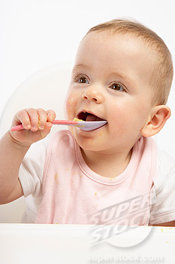
Identify this example as a form of energy …
From which form do humans get their energy?

Slide 32

Identify this example as a form of energy …
The light given off from a candle flame?

Slide 33
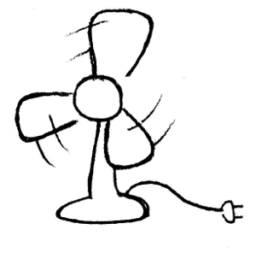
Identify this example as a form of energy …
The moving blades of a fan.

Slide 34
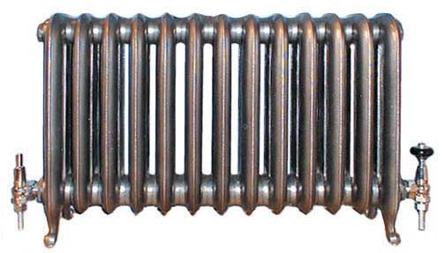
Identify this example as a form of energy …
The heat produced by a radiator.

Slide 35
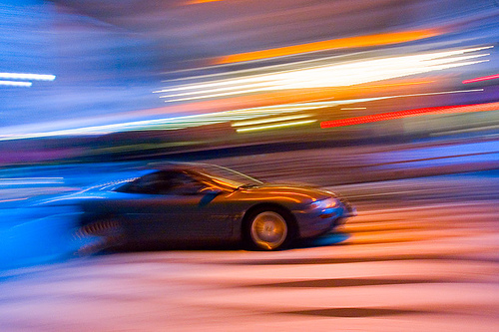
Identify this example as a form of energy …
The sound of a car speeding past.

Slide 36
Identify this example as a form of energy …
The sun’s energy.

